Slide 1


UNIT 5 Web Interface Design
Designing Web Interfaces - Drag & Drop, Direct Selection, Contextual Tools, Overlays, Inlays and Virtual Pages, Process Flow. Case Studies.

Slide 2


Drag & Drop
It was quite a while before drag and drop made its way to the Web in any serious application
The Events
Mouse Hover
The mouse pointer hovers over an object that is draggable.
Mouse Down
The user holds down the mouse button on the draggable object.
Drag Initiated
After the mouse drag starts (usually some threshold—3 pixels).
Drag Leaves Original Location
After the drag object is pulled from its location or object that contains it.

Slide 3
Drag & Drop
Drag Re-Enters Original Location
When the object re-enters the original location.
Drag Enters Valid Target
Dragging over a valid drop target.
Drag Exits Valid Target
Dragging back out of a valid drop target.
Drag Enters Specific Invalid Target
Dragging over an invalid drop target.
Drag Is Over No Specific Target
Dragging over neither a valid or invalid target. Do you treat all areas outside of valid targets as invalid?

Slide 4
Drag & Drop
Drag Hovers Over Valid Target
User pauses over the valid target without dropping the object.
This is usually when a spring loaded drop target can open up.
For example, drag over a folder and pause, the folder opens revealing a new area to drag into.
Drag Hovers Over Invalid Target
User pauses over an invalid target without dropping the object. Do you care? Will you want additional feedback as to why it is not a valid target?
Drop Accepted
Drop occurs over a valid target and drop has been accepted.
Drop Rejected
Drop occurs over an invalid target and drop has been rejected. Do you zoom back the dropped object?

Slide 5
Drag & Drop
Drop on Parent Container
Is the place where the object was dragged from special? Usually this is not the case,
but it may carry special meaning in some contexts.

Slide 6
Drag & Drop
The Actors
During each event you can visually manipulate a number of actors. The page elements available include:
Page (e.g., static messaging on the page)
Cursor
Tool Tip
Drag Object (or some portion of the drag object, e.g., title area of a module)
Drag Object’s Parent Container
Drop Target

Slide 7
Drag & Drop
Purpose of Drag and Drop
Drag and drop can be a powerful idiom if used correctly. Specifically it is useful for:
Drag and Drop Module
Rearranging modules on a page.
Drag and Drop List
Rearranging lists.
Drag and Drop Object
Changing relationships between objects.
Drag and Drop Action
Invoking actions on a dropped object.
Drag and Drop Collection
Maintaining collections through drag and drop.

Slide 8
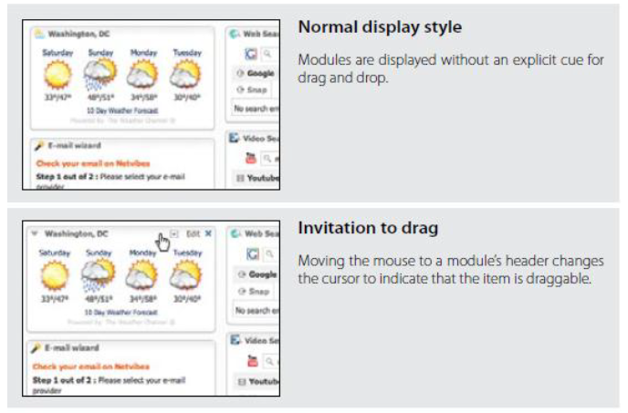
Drag & Drop
Drag and Drop Module
One of the most useful purposes of drag and drop is to allow the user to directly place objects where she wants them on the page. A typical pattern is Drag and Drop Modules on a page.

Slide 9
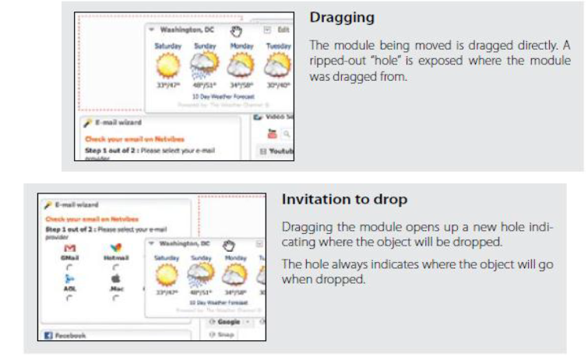
Drag & Drop

Slide 10
Drag & Drop
While dragging, it is important to make it clear what will happen when the user drops the dragged object.
There are two common approaches to targeting a drop:
Placeholder target
Insertion target
Placeholder target
Netvibes uses a placeholder (hole with dashed outline) as the drop target.
The idea (illustrated in Figure ) is to always position a hole in the spot where the drop would occur.

Slide 11
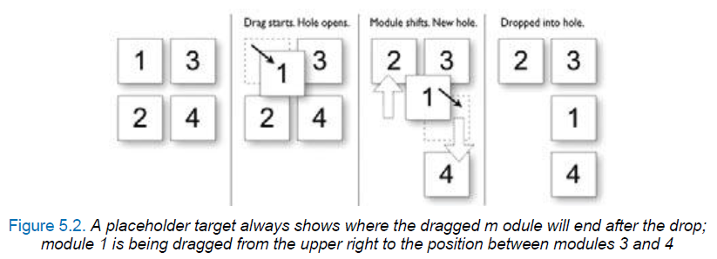
Drag & Drop
The hole serves as a placeholder and always marks the spot that the dragged module will land when dropped.
It also previews what the page will look like (in relation to the other modules) if the drop occurs there.

Slide 12
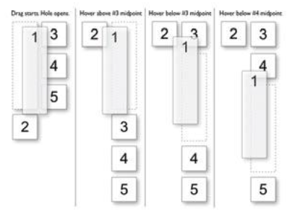
Drag & Drop
Boundary-based placement.
Since most sites that use placeholder targeting drag the module in its original size, targeting is determined by the boundaries of the dragged object and the boundaries of the dragged-over object.
Both Netvibes and iGoogle take the boundary-based approach.

Slide 13
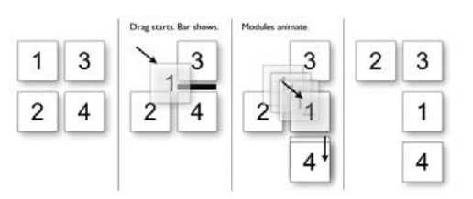
Insertion target
To keep the page as stable as possible and only move around an insertion target (usually an insertion bar).
When module 1 is dragged to the position between 3 and 4, an insertion bar is placed there.
This indicates that if 1 is dropped, then 4 will slide down to open up the drop spot.

Slide 14
Drag & Drop
Drag distance
Dragging the thumbnail around does have other issues. Since the object being dragged is small, it does not intersect a large area.
It requires moving the small thumbnail directly to the place it will be dropped.
With iGoogle, the complete module is dragged.
Since the module will always be larger than the thumbnail, it intersects a drop target with much less movement.
The result is a shorter drag distance to accomplish a move.

Slide 15
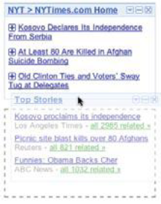
Drag & Drop
Drag rendering
How should the dragged object be represented? Should it be rendered with a slight transparency (ghost)? Or should it be shown fully opaque? Should a thumbnail representation be used instead?

Slide 16

Drag & Drop
Best Practices for Drag and Drop Module
Use the placeholder approach when showing a clear preview during drag is important.
Use the insertion bar approach when you want to avoid page jitter.
Use the midpoint of the dragged object to determine drag position.
Use a slightly transparent version of the object being dragged (ghost) instead of an opaque version.
If you drag thumbnail representations, use the insertion bar targeting approach.

Slide 17
Drag & Drop
Drag and Drop List
Rearranging lists is very similar to rearranging modules on the page but with the added constraint of being in a single dimension (up/down or left/right).
The Drag and Drop List pattern defines interactions for rearranging items in a list.

Slide 18
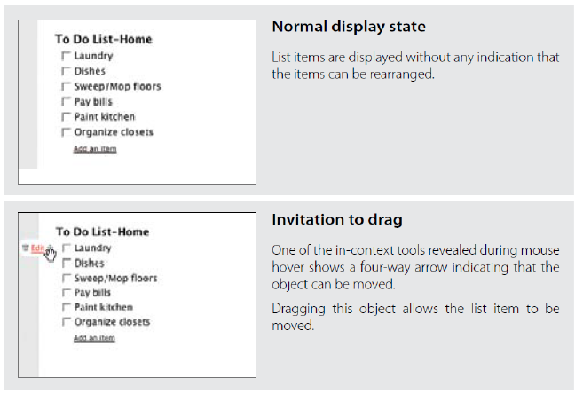
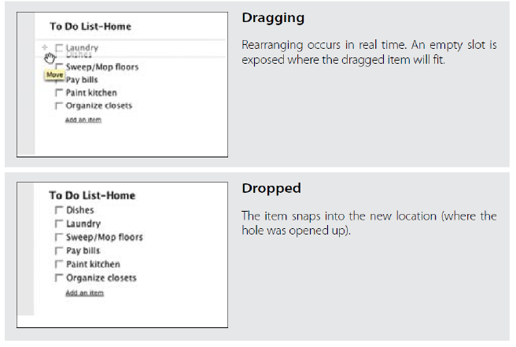
Drag & Drop
In a Drag and Drop List, use the mouse position to control where the item will be dropped.

Slide 19
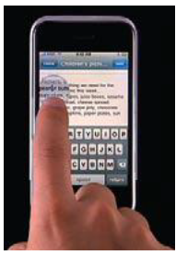
Drag lens
Drag and drop works well when a list is short or the items are all visible on the page.
But when the list is long, drag and drop becomes painful.
A drag lens provides a view into a different part of the list that can serve as a shortcut target.
It could be a fixed area that is always visible, or it could be a miniature view of the list that provides more rows for targeting.
A good example of this is dragging the insertion bar while editing text on the iPhone

Slide 20
Best Practices for Drag and Drop List
If possible, drag the items in a list in real time using the placeholder target approach.
Use the mouse position for drag target positioning.
If the goal is speed of dragging or if dragged items are large, consider using the insertion target approach, as rendering an insertion bar is inexpensive compared to dynamically rearranging the list.
Since drag and drop in lists is not easily discoverable, consider providing an alternate way to rearrange the list.
When the user rearranges the list with an alternate method, use that moment for a one time advertisement for drag and drop

Slide 21
Drag and Drop Object
Another common use for drag and drop is to change relationships between objects.
This is appropriate when the relationships can be represented visually.
Drag and drop as a means of visually manipulating relationships is a powerful tool.
Cogmap is a wiki for organizational charts. Drag and Drop Object is used to rearrange members of the organization

Slide 22
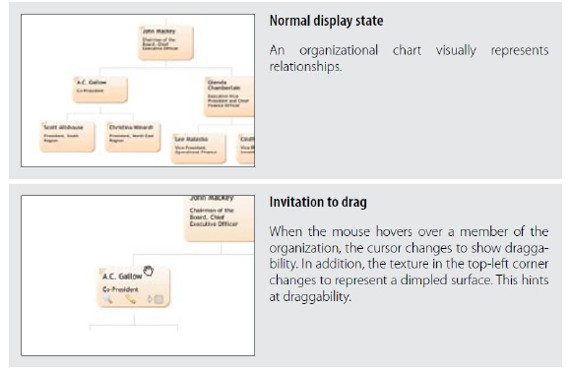

Slide 23
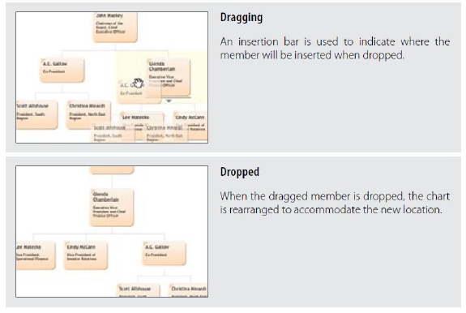
Cogmap allows organizational charts to be rearranged on the fly with drag and drop

Slide 24
Best Practices for Drag and Drop Object
Best Practices for Drag and Drop Object
If objects are represented in a complex visual relationship, use insertion targeting to indicate drop location (minimizes disturbing the page during drag).
For parent/child relationships, highlight the parent as well to indicate drop location.
If possible, reveal drag affordances on mouse hover to indicate draggability.
Initiate drag when the mouse is dragged three pixels or if the mouse is held down for at least half a second.
Position dragged objects directly in sync with the cursor. Offsetting will make the drag feel disjointed.
When hovering over a draggable object, change the cursor to indicate draggability.

Slide 25
Drag and Drop Action
Drag and drop is also useful for invoking an action or actions on a dropped object.
The Drag and Drop Action is a common pattern.
Its most familiar example is dropping an item in the trash to perform the delete action.
Normally uploading files to a web application includes pressing the upload button and browsing for a photo.
This process is repeated for each photo. When Yahoo! Photos was relaunched in 2006, it included a drag and drop upload feature.
It allowed the user to drag photos directly into the upload page. The drop signified the upload action

Slide 26
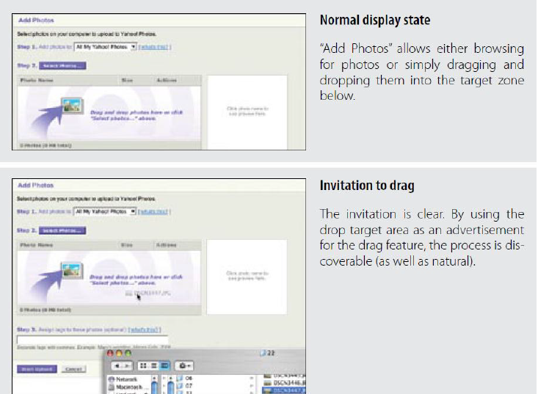
Yahoo! Photos

Slide 27
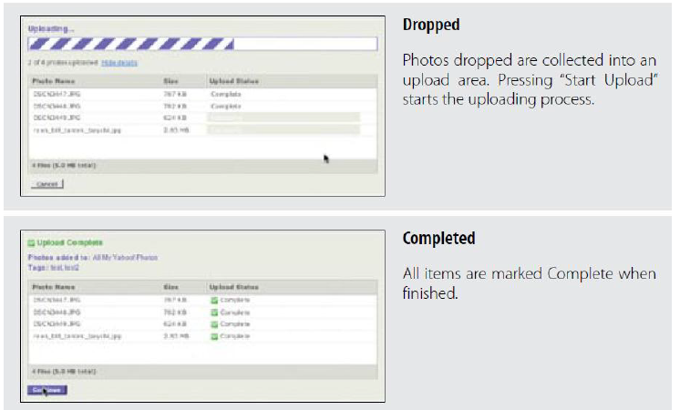

Slide 28
Best Practices for Drag and Drop Action
Use Drag and Drop Actions sparingly in web interfaces, as they are not as discoverable or expected.
Provide alternate ways to accomplish the action. Use the Drag and Drop Action as a shortcut mechanism.
Don’t use drag and drop for setting simple attributes. Instead use a more direct approach to setting attributes on the object.
Don’t construct an artificial visual representation for the sole purpose of implementing drag and drop. Drag and drop should follow the natural representation of the objects in the interface.
Provide clear invitations on hover to indicate the associated action.

Slide 29
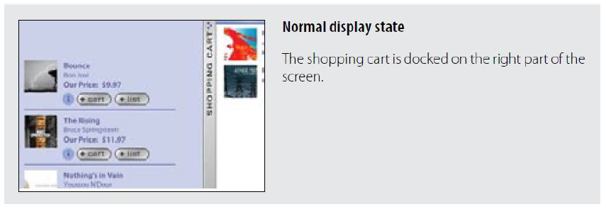
Drag and Drop Collection
A variation on dragging objects is collecting objects for purchase, bookmarking, or saving into a temporary area.
This type of interaction is called Drag and Drop Collection.
Drag and drop is a nice way to grab items of interest and save them to a list.
The Laszlo shopping cart example illustrates this nicely

Slide 30
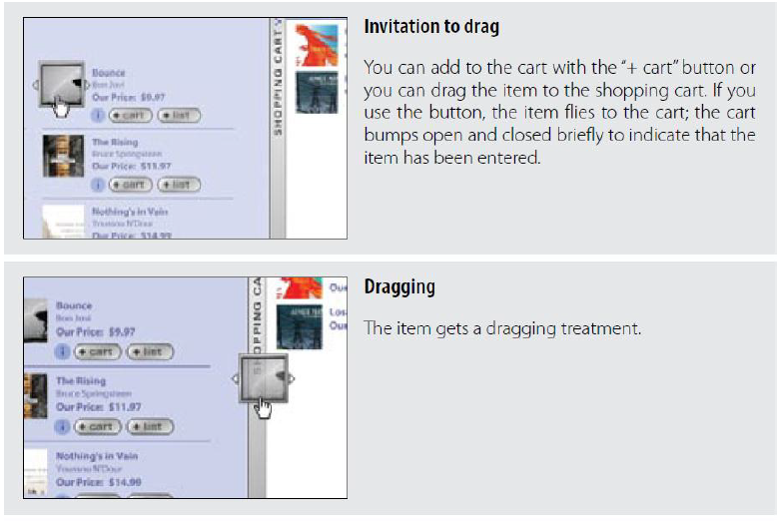

Slide 31
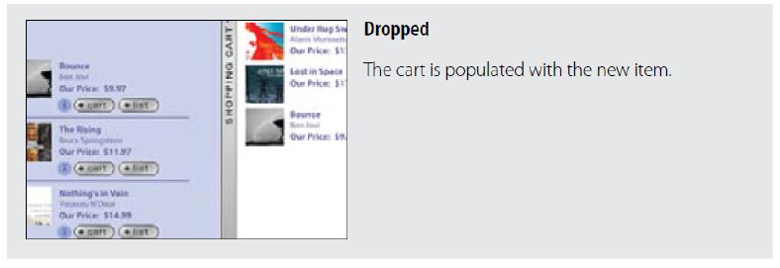
This Laszlo shopping cart demo uses both drag and d rop and a button action to add items to its shopping cart

Slide 32
Best Practices for Drag and Drop Collection
Here are some best practices to keep in mind:
Use as an alternate way to collect items (e.g., a shopping cart).
When a drag gets initiated, highlight the valid drop area to hint where drop is available.
Provide alternate cues that drag and drop into collections as available.

Slide 33
Challenges of Drag and Drop
Drag and Drop is complex.
There are four broad areas where Drag and Drop may be employed: Drag and Drop Module, Drag and Drop List, Drag and Drop Object, and Drag and Drop Action.

Slide 34
General Best Practices for Drag and Drop
Keep page jitter to a minimum while dragging objects.
Initiate dragging if the user presses the mouse down and moves the mouse three pixels, or if she holds the mouse down for at least half a second.
Use drag and drop for performing direct actions as an alternate method to more direct mechanisms in the interface.
Hint at the availability of drag and drop when using alternatives to drag and drop.
Pay attention to all of the interesting moments during drag and drop. Remember, you must keep the user informed throughout the process.
Use Invitations to cue the user that drag and drop is available.

Slide 35
Direct Selection
Toggle Selection
Checkbox or control-based selection.
Collected Selection
Selection that spans multiple pages.
Object Selection
Direct object selection.
Hybrid Selection
Combination of Toggle Selection and Object Selection

Slide 36
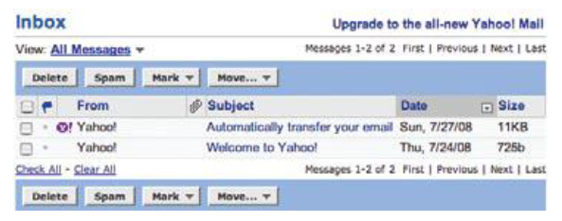
Toggle Selection
The most common form of selection on the Web is Toggle Selection.
Checkboxes and toggle buttons are the familiar interface for selecting elements on most web pages.
An example of this can be seen in Figure with Yahoo! Mail Classic.
In Yahoo! Mail Classic a mail message can be selected by clicking on the corresponding row’s checkbox

Slide 37
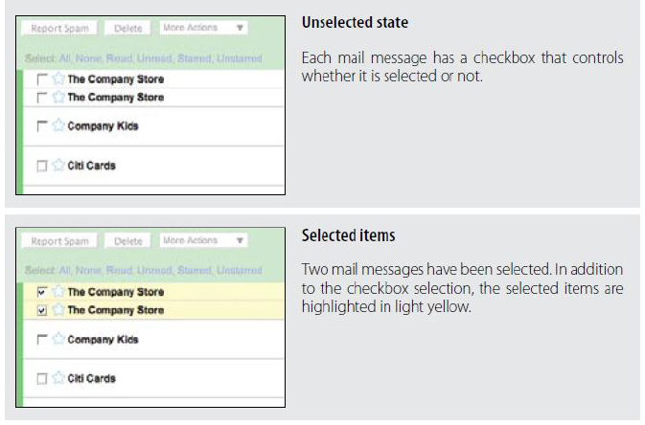
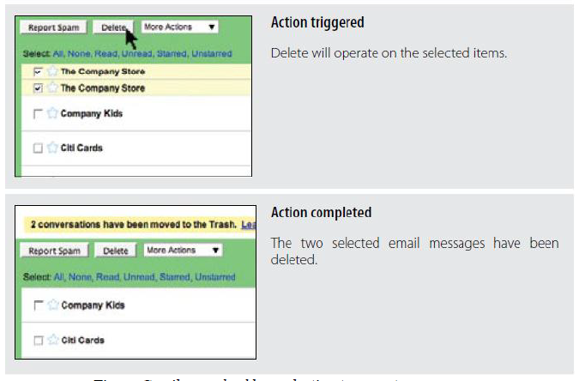
Gmail uses checkbox selection to operate on messages

Slide 38
Toggle Selection with checkboxes
Toggle Selection with checkboxes has some nice attributes:
Clear targeting, with no ambiguity about how to select the item or deselect it.
Straightforward discontinuous selection, and no need to know about Shift or Control key ways to extend a selection. Just click the checkboxes in any order, either in a continuous or discontinuous manner.
Clear indication of what has been selected.

Slide 39
Best Practices for Toggle Selection
Use Toggle Selection for selecting elements in a row.
Use Toggle Selection to make it easy to select discontinuous elements.
In a list, highlight the row in addition to the checkbox to make the selection explicit.
When moving from page to page, actions should only operate on the items selected on that page.
If offering a “select all” option, consider providing a way to select all elements across all pages.
Provide clear feedback for the number of elements selected.
If possible, disable unavailable actions when nothing is selected. If you keep the action enabled, you will need additional interface elements to signal that it can’t be completed.

Slide 40
Collected Selection
Toggle Selection is great for showing a list of items on a single page.
But what happens if you want to collect selected items across multiple pages? Collected Selection is a pattern for keeping track of selection as it spans multiple pages.
In Gmail, you can select items as you move from page to page. The selections are remembered for each page.
If you select two items on page one, then move to page two and select three items, there are only three items selected.

Slide 41
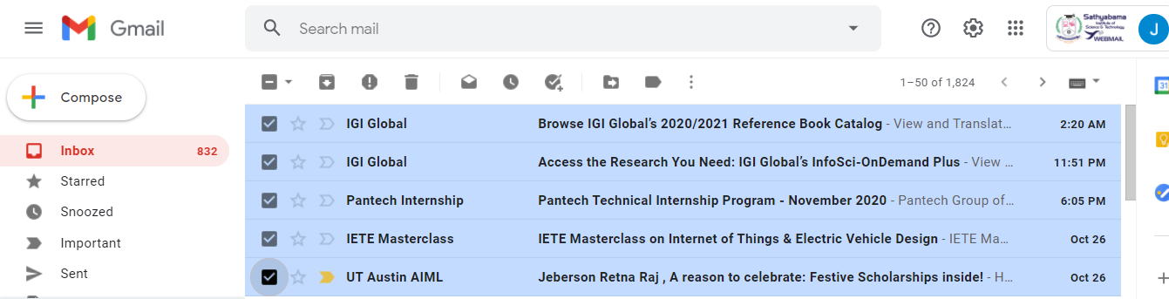
Gmail provides a way to select all items across all pages, allowing the user to delete all items in a folder without having to delete all items on each page individually

Slide 42
Best Practices for Collected Selection
If you allow selection across page boundaries, accumulate the selected items (from each page) into a separate area. This makes the selection explicit even when moving from page to page.
Use Collected Selection to blend Toggle Selection and Object Selection in the same interface.
Watch out for ambiguity between items selected with Collected Selection and any items or objects that can be normally selected on the page.

Slide 43
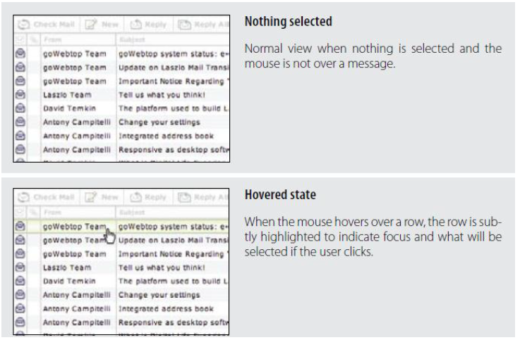
Object Selection
Toggle Selection is the most common type of selection on the Web.
The other type of selection, Object Selection, is when selection is made directly on objects within the interface.

Slide 44
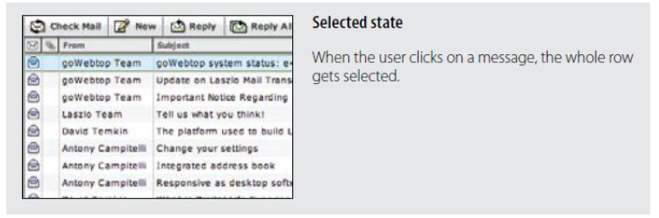
Laszlo WebTop Mail uses highlighting to indicate row selection

Slide 45
Best Practices for Object Selection
Best Practices for Object Selection
Use Object Selection when selectable elements can be dragged.
Use Object Selection when the application will simulate desktop style interactions.
Allow standard modifier key extensions (Shift to extend selection; Ctrl for discontinuous selection).
If possible, degrade Object Selection to Toggle Selection when browser capabilities are limited.

Slide 46
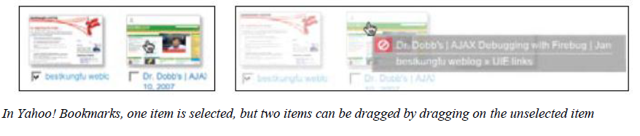
Hybrid Selection
Mixing Toggle Selection and Object Selection in the same interface can lead to a confusing interface.
Referring back to Yahoo! Bookmarks, you’ll see an odd situation arise during drag and drop.

Slide 47
Hybrid Selection
Toggle Selection is used for selecting bookmarks for editing, deleting, etc.
Object Selection is used for initiating a drag drop.
Mouse click is used to open the bookmark on a separate page.

Slide 48
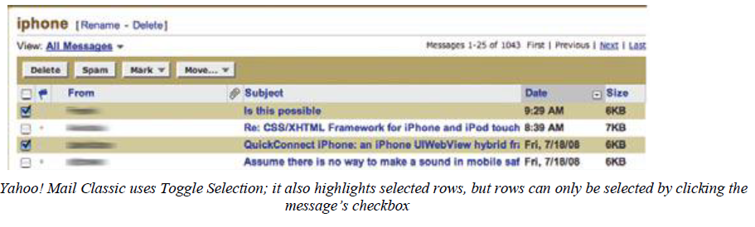
Blending two models
Yahoo! Mail originally started with the Toggle Selection model (Figure ).
When the new Yahoo! Mail Beta was released, it used Object Selection exclusively (Figure).
But since there are advantages to both approaches, the most recent version of Yahoo! Mail incorporates both approaches in a Hybrid Selection (Figure ).

Slide 49
Best Practices for Hybrid Selection
Best Practices for Hybrid Selection
Use checkbox selection to select an object without opening it.
Use object selection to select and open an object.

Slide 50
Contextual Tools
Contextual Tools are the Web’s version of the desktop’s right-click menus.
Instead of having to right-click to reveal a menu, we can reveal tools in context with the content. We can do this in a number of ways:
Always-Visible Tools
Place Contextual Tools directly in the content.
Hover-Reveal Tools
Show Contextual Tools on mouse hover.
Toggle-Reveal Tools
A master switch to toggle on/off Contextual Tools for the page.
Multi-Level Tools
Progressively reveal actions based on user interaction.
Secondary Menus
Show a secondary menu (usually by right-clicking on an object).

Slide 51
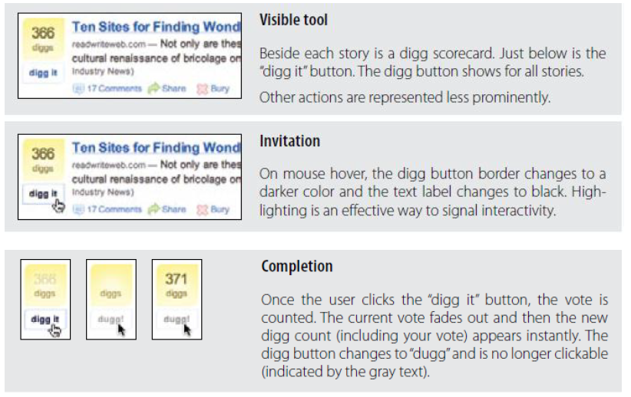
Always-Visible Tools
The simplest version of Contextual Tools is to use Always-Visible Tools. Digg is an example of making Contextual Tools always visible (Figure 4-3).

Slide 52
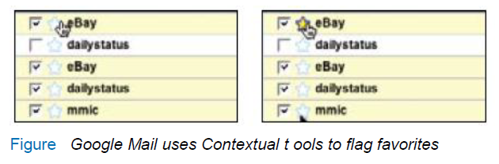
Always-Visible Tools
Discoverability
Discoverability is a primary reason to choose Always-Visible Tools. On the flip side, it can lead to more visual clutter.
Generally Contextual Tools in a list work well when the number of actions is kept to a minimum. Gmail provides a single Always-Visible Tool in its list of messages—the star rating—for flagging emails (Figure ).

Slide 53
Always-Visible Tools
Best Practices for Always-Visible Tools
Make your Contextual Tools always visible if it is important to make a prominent call to action.
Keep visual clutter to a minimum.
Keep the number of visual items to a minimum.

Slide 54
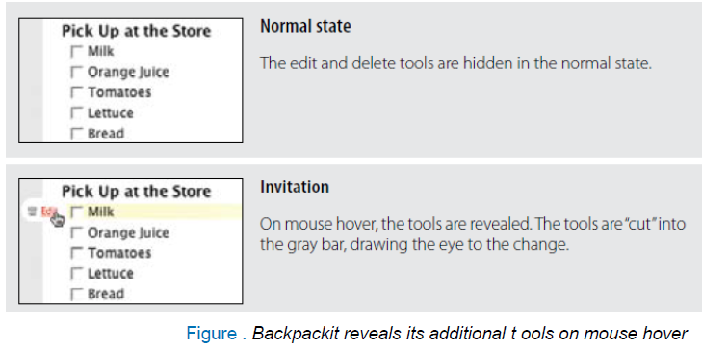
Hover-Reveal Tools
Instead of making Contextual Tools always visible, we can show them on demand.
One way to do this is to reveal the tools when the user pauses the mouse over an object.

Slide 55
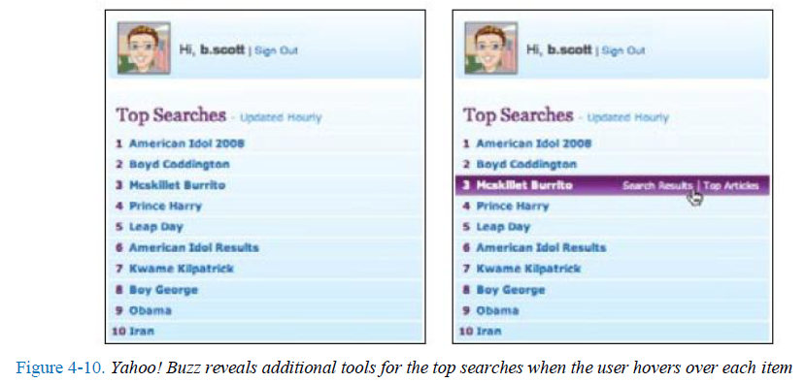
Hover-Reveal Tools
For Top Searches, it is important to keep the top-ten list as simple as possible. Showing tools would compete with the list itself. Since the actions “Search Results” and “Top Articles” (Figure 4-10, right) are less important, they are revealed on hover. The actions may be important, but making the content clear and readable is a higher priority.

Slide 56
Best Practices for Hover-Reveal Tools
Hide Contextual Tools behind a mouse hover if the actions are secondary and you want to make the content more important (or other visible commands more important).
Avoid using overlays when revealing additional tools. They will lead to the Hover and Cover anti-pattern, as well as require the user to perform mouse gymnastics to accomplish the most basic tasks.
When additional tools are revealed, make sure that all parts of the page remain stable. Avoid any element shifting by a few pixels or page elements moving around. These cause the user to be directed away from what is really happening.
Make sure revealed icons are clear and understandable. When possible, just use text labels.
Activate tool overlays instantly. Unlike informational overlays, the user needs the additional tools to be available for immediate interaction.

Slide 57
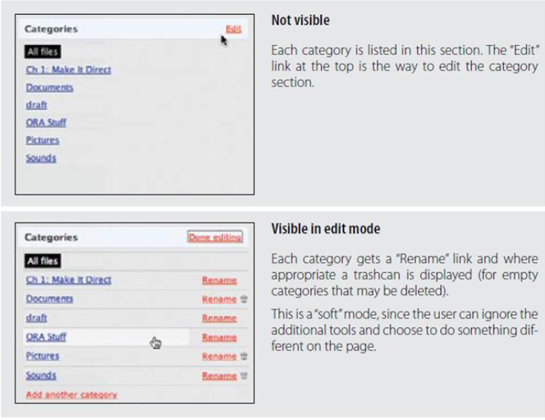
Toggle-Reveal Tools
A variation on the two previous approaches is to not show any Contextual Tools until a special mode is set on the page.
A good example of Toggle-Reveal Tools is in Basecamp’s category editing

Slide 58
Best Practices for Toggle-Reveal Tools
Toggle a tool mode for an area or page when the actions are not the main flow, but you want to provide the most direct way to act on these objects when the need arises.
Make the activation and deactivation of the edit mode as symmetrical as possible.
Keep the transition between display and edit as seamless as possible to provide a “soft mode” for editing.

Slide 59
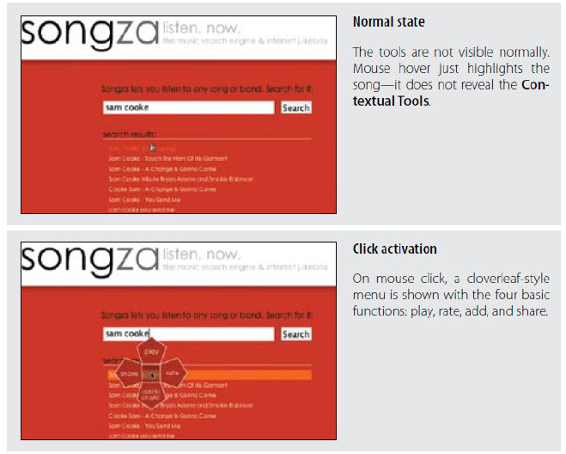
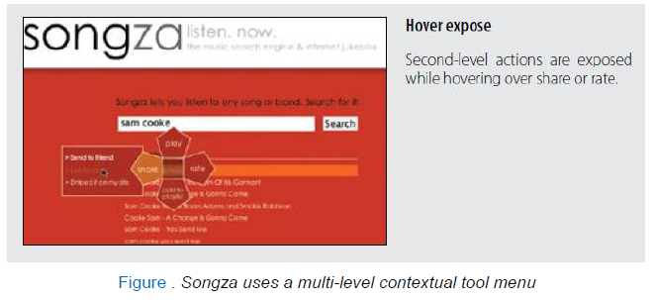
Multi-Level Tools
Contextual Tools can be revealed progressively with Multi-Level Tools. Songza* provides
a set of tools that get revealed after a user clicks on a song. Additional tools are revealed when hovering over the newly visible tools

Slide 60
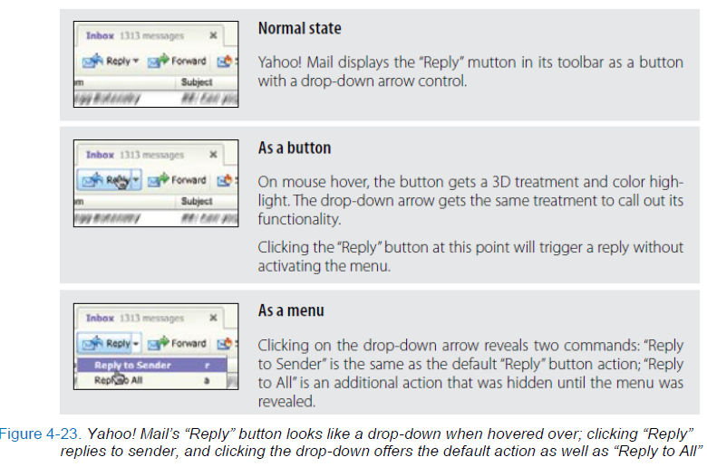
Muttons
Another variation on Multi-Level Tools is the “mutton” (menu + button = mutton). Muttons are useful when there are multiple actions and we want one of the actions to be the default. Yahoo! Mail uses a mutton for its “Reply” button

Slide 61
Muttons
Clicking “Reply” performs the individual reply. To reply to all, the menu has to be activated by clicking on the drop-down arrow to show the menu. Muttons are used to:
Provide a default button action (“Reply to Sender”)
Provide a clue that there are additional actions
Provide additional actions in the drop-down

Slide 62
Best Practices for Multi-Level Tools
Use Multi-Level Tools when you want to avoid revealing Contextual Tools on a mouse hover.
Use Multi-Level Tools to make activation explicit.
Use muttons when you have a default action that the user normally takes but alternate actions are still fairly frequent.
Avoid cascades where possible. Users have a hard time maneuvering the various mouse turns that are required to get to these secondary menus.
Keep actions as close to the activation point as possible.

Slide 63
Secondary Menu
Desktop applications have provided Contextual Tools for a long time in the form of Secondary Menus.
These menus have been rare on the Web. Google Maps uses a secondary menu that is activated by a right-click on a route.
It shows additional route commands

Slide 64
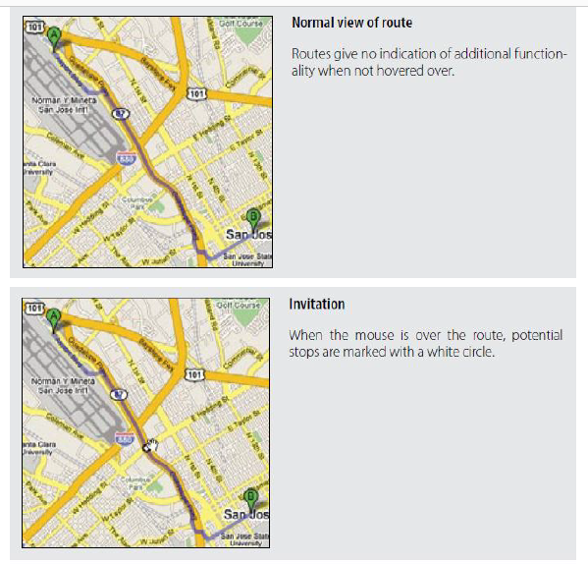

Slide 65
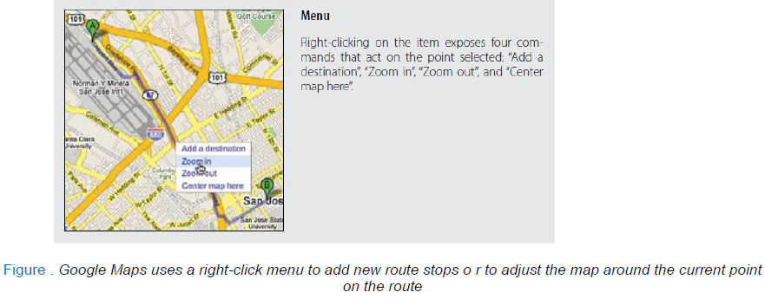

Slide 66
Best Practices for Secondary Menus
Place alternate or shortcut commands in Secondary Menus.
Consider activating Secondary Menus by holding down the mouse for one second as an alternative to right-clicking to show the menu.
Style Secondary Menus differently than the Browser’s standard secondary menu.
Avoid Secondary Menus for all but redundant commands
Avoid Secondary Menus in places where there is little resemblance to a traditional web page.
Use Secondary Menus for operating on a selected set of objects.

Slide 67
General Practices for Contextual Tools
Use Contextual Tools when you have no way to select elements and operate on them as a whole.
Use Contextual Tools when you want to shorten the path the user must take to complete a task for an item shown on the page.
Use Contextual Tools when you want to provide a clear call to action at the point of focus.
Always make your actions as immediate as possible, avoiding additional steps where you can.
Where possible use familiar techniques (hyperlinks, drop-down arrows, buttons) when providing actions in unexpected places (hover-revealed Contextual Tools).

Slide 68
General Practices for Contextual Tools
Make the actions clear and direct. Avoid using icons for all but the most obvious (an [x] or a trashcan for delete, for instance).
Use buttons for strong calls to action and links for minor actions.
Make sure that targets used to open menus or expand information are suitably sized. Never use 8×8 pixel targets.
Make tools easy to understand, easy to target, and quick to execute. This will make them feel lightweight.

Slide 69
Overlays
Overlays are really just lightweight pop ups. We use the term lightweight to make a clear distinction between it and the normal idea of a browser pop up.
Browser pop ups are created as a new browser window (Figure ).
Lightweight overlays are shown within the browser page as an overlay (Figure ).

Slide 70
Overlays
Older style browser pop ups are undesirable because:
Browser pop ups display a new browser window. As a result these windows often take time and a sizeable chunk of system resources to create.
Browser pop ups often display browser interface controls (e.g., a URL bar). Due to security concerns, in Internet Explorer 7 the URL bar is a permanent fixture on any browser pop-up window.

Slide 71
Overlays
By using either Flash or Ajax-style techniques (Dynamic HTML), a web application can present a pop up in a lightweight overlay within the page itself. This has distinct advantages:
Lightweight overlays are just a lightweight in-page object. They are inexpensive to create and fast to display.
The interface for lightweight overlays is controlled by the web application and not the browser.
There is complete control over the visual style for the overlay. This allows the overlay to be more visually integrated into the application’s interface (compare Figures 5-1and 5-2).

Slide 72
Lightweight overlays
Lightweight overlays can be used for asking questions, obtaining input, introducing features, indicating progress, giving instructions, or revealing information.
They can be activated directly by user events (e.g., clicking on an action, hovering over objects) or be provided by the web application at various stages in the completion of an action.

Slide 73
Figure . Orbitz uses a lightweight DHTML overlay for its calendar chooser; since it does not require the overhead of a separate browser window, it can pop up quickly and is better integrated into the page visually

Slide 74
Dialog Overlay
Dialog Overlays replace the old style browser pop ups. Netflix provides a clear example of a very simple Dialog Overlay. In the “previously viewed movies for sale” section, a user can click on a “Buy”
button to purchase a DVD. Since the customer purchasing the DVD is a member of Netflix, all the pertinent shipping and purchasing information is already on record. The complete checkout experience can be provided in a single overlay (Figure).

Slide 75
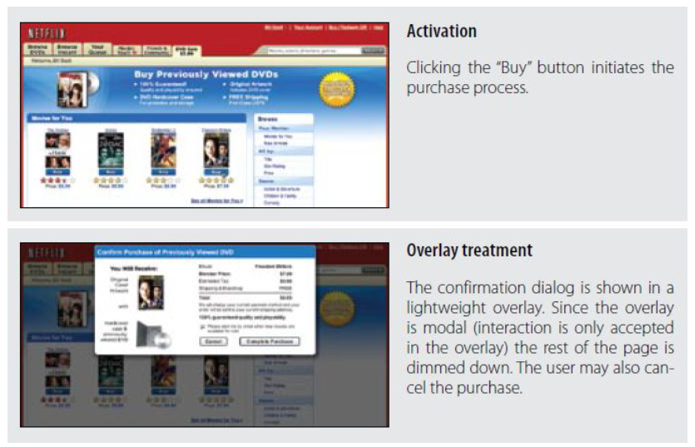
Figure 5-3. Netflix uses a lightweight pop up to confirm a previously viewed DVD purchase; in addition, it uses the Lightbox Effect to indicate modality

Slide 76
Best Practices for Dialog Overlay
Always use Dialog Overlays instead of browser pop ups.
Use the Lightbox Effect when the overlay contains important information, if the user should not ignore it, or if the interaction with the dialog should be modal.
Avoid unnecessary Dialog Overlays (Idiot Boxes), as they interrupt the user’s flow.
Don’t use an overlay when a simpler, in-page interaction would suffice (see discussion inthe next chapter on Inlays).
Avoid JavaScript alert boxes, as they don’t provide a consistent user experience between operating systems.

Slide 77
Detail Overlay
The second type of overlay is somewhat new to web applications. The Detail Overlay allows an overlay to present additional information when the user clicks or hovers over a link or section of content.
Toolkits now make it easier to create overlays across different browsers and to request additional information from the server without refreshing the page. Taking another example from Netflix, information about a specific movie is displayed as the user hovers over the movie’s box shot (Figure ).

Slide 78
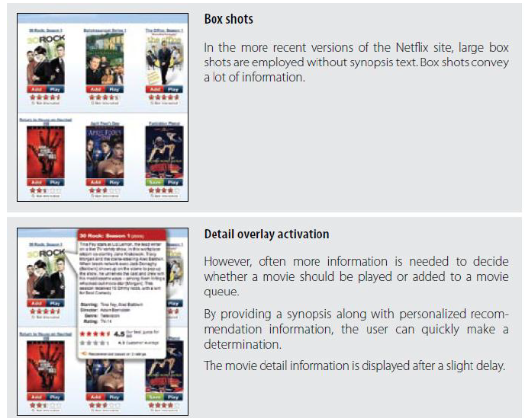
Detail Overlay

Slide 79
Best Practices for Detail Overlay
Best Practices for Detail Overlay
Use Detail Overlays to give a sneak peek at detailed information. This will avoid unnecessary page transitions.
For hover-activated Detail Overlays, provide a slight delay for activation (about half a second). This will avoid the interface behaving like a Mouse Trap.
For hover-activated Detail Overlays, provide a simple deactivation (e.g., simple mouse out).
For Detail Overlays, make activation and deactivation symmetrical (don’t make it harder to get out of the overlay than it was to activate it).
Once activated, avoid lengthy animations or effects that delay showing a Detail Overlay.

Slide 80
Best Practices for Detail Overlay
Use hover when clicking the object is reserved for a different action. In Yahoo! News, clicking on the link takes you to the news story page. Hovering gives you a sneak peek.
Use hover when it is not obvious how to get more information. If you use hover to activate the details, you don’t need additional user interface controls for activation.
Use click if you prefer to make getting details more explicit. Usually you will couple this with a “see more” or a button that exposes more detail. Yahoo! Foods (Figure 5-11) uses a red arrow to indicate drop-down information. AOL Finance uses a blue arrow button to indicate more information (Figure 3-10).
Use click if you will be providing additional links inside the overlay. Trying to keep an overlay in place (that was activated by hover) and click a link inside it is difficult.

Slide 81
Input Overlay
Input Overlay is a lightweight overlay that brings additional input information for each field tabbed into. American Express uses this technique in its registration for premium cards such as its gold card (Figure ).

